Slide 1

“To-Do List”
Task - 1

Slide 2

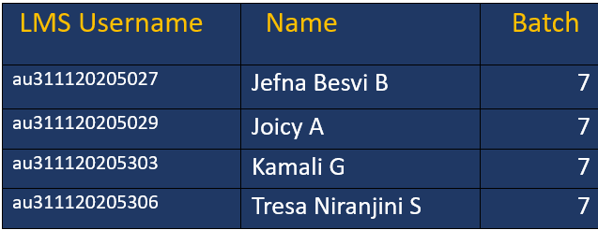
To-Do List
▪
A to-do list serves as the cornerstone for organized execution. It acts as a dynamic roadmap, guiding the team through tasks, deadlines, and priorities.
LMS Username
Name
Batch

Slide 3
Task-1
Creation of SRS & Github
To create SRS for our project To Do List.
Creation & Set-up of Github account - Created
Creation & Hands-on to various commands of Git Bash - Created
EvaluationꢀMetric:
● 100% Completion of the above tasks
Learning Outcome
Get to know about different lifecycle models.
Understanding importance and how to create an SRS
Knowing various commands of Github
Understanding agile and scrum management techniques for efficient product development

Slide 4

Step-Wise Description
Clearly outline project objectives, features, and limitations.Gather both functional and non-functional requirements.
Select programming languages, frameworks, and tools that has to be used .
Review the SRS with stakeholders, document assumptions and constraints, and implement version control for ongoing documentation management.
Summary of Task1
Setting Up and Getting Familiar with Version Control
By completing the SRS, we’ve set a solid foundation for the development phase.
Explored and practiced various Git Bash commands for version control.
Successfully created a GitHub account to facilitate collaborative development.

Slide 5

Assessment Parameter
Gather requirements for the
project “To-Do list”
add Readme.md file with
description of the project
Prepare database design
schemas
Check-List
Commit all changes with "first
commit"
Get your initial project
Structure ready
create a repository on github
realted to project
Initiate a git repository
Push your changes to github

Slide 6

Submission Github
https://github.com/tresaniranjini/NM-LICET-IT-8

Slide 7


